Slide 1
C# Language
Clean Architecture
What is Clean Architecture?
Solution structure
Corso C#

Slide 2
What is Clean Architecture?
What is Clean Architecture?
Applications that follow the Dependency Inversion Principle as well as the Domain-Driven Design (DDD) principles tend to arrive at a similar architecture
This architecture has gone by many names over the years:
Hexagonal Architecture
Ports-and-Adapters
More recently:
Onion Architecture
Clean Architecture
Presentation
Application
Domain
Infrastructure
Corso C#

Slide 3
What is Clean Architecture?
Template
You can find a Solution Template that uses this approach
in this GitHub Repositories two ideas of Clean Architecture:
https://github.com/jasontaylordev/CleanArchitecture
https://github.com/ardalis/cleanarchitecture
by installing these templates:
https://www.nuget.org/packages/Clean.Architecture.Solution.Template
https://www.nuget.org/packages/Ardalis.CleanArchitecture.Template
Corso C#

Slide 4
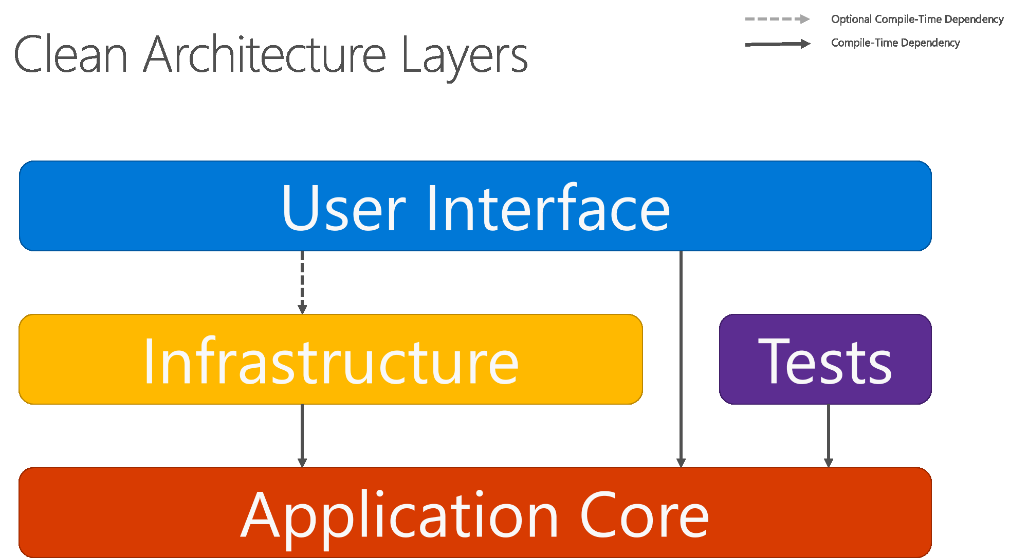
What is Clean Architecture?
Clean Architecture Layers
the solid arrows represent compile-time dependencies, while the dashed arrow represents a runtime-only dependency
With the clean architecture, the UI layer works with interfaces defined in the Application Core at compile time, and ideally shouldn't know about the implementation types defined in the Infrastructure layer
At run time, however, these implementation types are required for the app to execute, so they need to be present and wired up to the Application Core interfaces via dependency injection
Corso C#

Slide 5
What is Clean Architecture?
Clean Architecture Layers
Clean architecture puts the business logic and application model at the center of the application
Instead of having business logic depend on data access or other infrastructure concerns, this dependency is inverted: infrastructure and implementation details depend on the Application Core
This functionality is achieved by defining abstractions, or interfaces, in the Application Core, which are then implemented by types defined in the Infrastructure layer
A common way of visualizing this architecture is to use a series of concentric circles, similar to an onion
Presentation
Application
Domain
Infrastructure
Corso C#

Slide 6
What is Clean Architecture?
Clean Architecture Layers
Domain layer: the core of the system (defines entities, main business rules, aggregates, value objects, domain events and handlers (if using Domain Driven Design), repository interfaces, factory interfaces, domain services, custom exceptions, etc.); it cannot reference the other layers
Application layer: orchestrates the Domain layer and manage how to perform the business logic, implements the most important use cases; Is typically implemented as a set of application services; If you are using the CQRS pattern you put here Commands an Queries
Infrastructure Layer: anything related to external systems; here you define Database access, message queues (like Kafka), email and notification services, storage services, etc. it is responsible for hiding the implementation detail for any external system that you need to integrate with
Presentation layer: defines the entry point for outer users to interact with your system; typically it implements RESTful APIs, gRPS, and so on…
Presentation
Application
Domain
Infrastructure
Corso C#

Slide 7
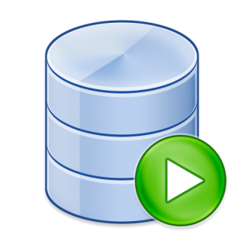

What is Clean Architecture?
Clean Architecture Layers
Because the Application Core doesn't depend on Infrastructure, it's very easy to write automated unit tests for this layer
Integration tests can also be implemented for Infrastructure layer by adding external dependencies
Since the UI layer doesn't have any direct dependency on types defined in the Infrastructure project, it's likewise very easy to swap out implementations, either to facilitate testing or in response to changing application requirements
ASP.NET Core's built-in use of and support for dependency injection makes this architecture the most appropriate way to structure non-trivial monolithic applications
Presentation
Application
Unit Tests
Domain
Integration Tests
Infrastructure
Corso C#

Slide 8
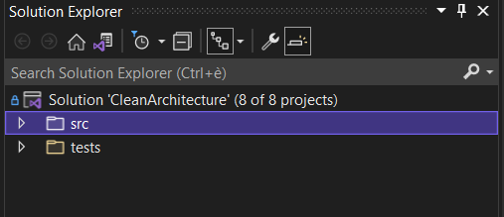
Solution structure
Folder structure
Two main folders:
src: the actual source code of the application
tests: solutions tests (functional, integration, unit)
Each folder contains many projects
Corso C#

Slide 9
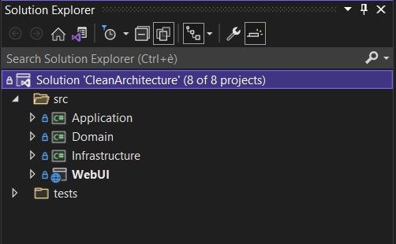
Solution structure
src folder
src folder contains the actual application source code where each layer is identified with its own project.
From inside to outside:
Domain
Application
Infrastructure
Web Project (aka presentation layer)
In a Clean Architecture solution, each project has clear responsibilities
as such, certain types belong in each project and you'll frequently find folders corresponding to these types in the appropriate project
Corso C#

Slide 10
Solution structure
The Core Layer
The Core Layer is made up of two parts:
the inner core (the domain)
the outer core (the application)
This consists of two projects:
Domain project
Application project
Corso C#

Slide 11
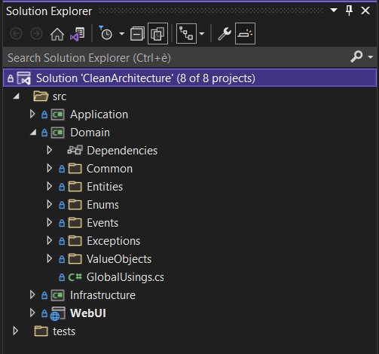
Solution structure
Inner Core (Domain Layer)
This layer contains application-independent business logic. This is the part of the business logic which would be the same even if we weren’t building a software. It is a formulation of the core business rules.
The organization of this project follows Domain-Driven design patterns, although this is a matter of preference and can be handled any way you see fit. This includes:
Aggregates (groups of entities), entities (business model classes that are persisted), value objects, custom domain exceptions, DTOs, and interfaces for domain services.
Interfaces for domain-driven design concepts (i.e. IAggregateRoot, IDomainEvent, IEntity).
Base implementations of aggregate root and domain event. Also contains specific domain events and handlers pertaining to the business processes
Corso C#

Slide 12
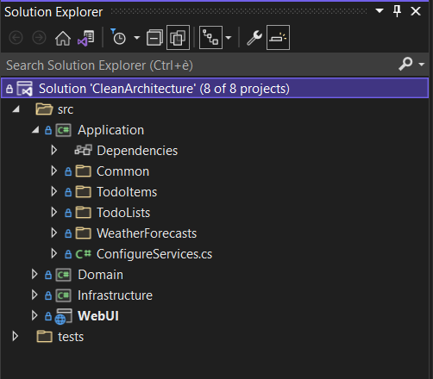
Solution structure
Outer Core (Application Layer)
This layer contains application-specific business logic. It only depends on Domain project. This contains the “what” the system should do. This includes:
Interfaces for infrastructure components such as repositories, unit-of-work and event sourcing.
Commands and Queries models and handlers
Interfaces and DTOs for cross-cutting concerns (i.e. service bus)
Authorization operations, requirements and handlers implementations
Interfaces and concrete implementations of application-specific business logic services.
Mapping profiles between domain entities and CQRS models
NOTE: it contains the abstraction of, for example, a database access, but it does not contain the concrete implementation
Corso C#

Slide 13
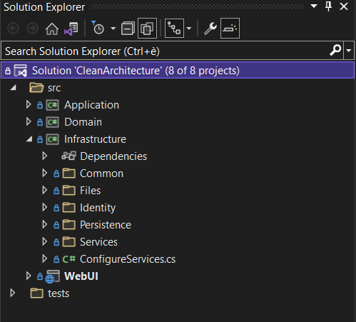
Solution structure
The Infrastructure Layer
This layer contains details, concrete implementations for repositories, unit-of-work, event store, service bus implementations etc. It directly depends on Application project. It contains the “how” the system should do what is supposed to do. The decoupling between the application layer and the infrastructure layer is what allows solution structures like this one to change and/or add specific implementations as the project requirements change.
In overview, this layer contains:
Generic and specific repositories implementations
EF DbContexts, data models and migrations
Event sourcing persistence and services implementations
Implementations for cross-cutting concerns (i.e, application configuration service, localization service etc.)
Data entity auditing implementation
Corso C#

Slide 14
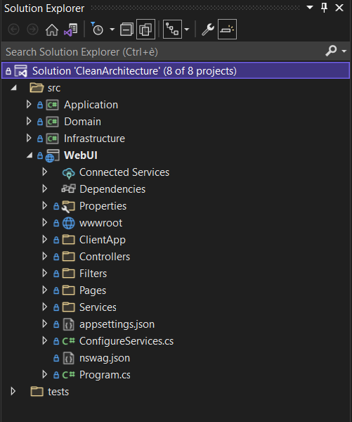
Solution structure
The Presentation Layer
This layer essentially contains the I/O components of the system, the GUI, REST APIs, mobile applications or console shells, and anything directly related to them.
It depends on Application and Infrastructure projects but, important: The onflu reason because it depends also on Infrastructure layer is to do service registration on Startup.cs.
It is the starting point of our application.
For this starting point solution, it contains the following:
ASP.NET Core MVC web application using Razor Components
A shared class library containing common Razor Components, such as toast notifications, modal components, Blazor Select2, DataTablesJS integration and CRUD buttons
Corso C#

Slide 15
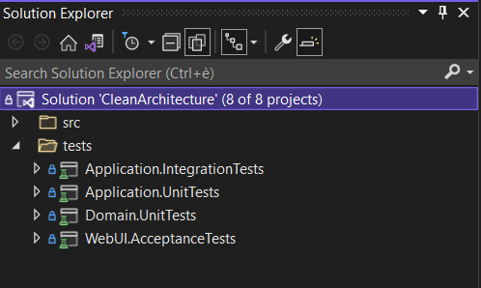
Solution structure
tests folder
tests folder contains one project per type of test per project
Application project has both unit tests and integration tests so, tests folder will contain two projects: - Application.UnitTests - Application.IntegrationTests
Domain project has unit tests so, tests folder will contain: - Domain.UnitTests
WebUI project has acceptance tests so, tests folder will contain: - WebUI.AcceptanceTests
and so on…
Corso C#

